Slide 1


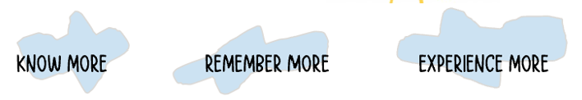
Year 1 Parent Planner – My Place, My Time
Vital Vocabulary
Geography and History
UK, town, village, city, map, weather, old, new, past and present
Science
Animal, human, mammal, amphibian, fish, reptile, bird, omnivore, herbivore, carnivore, body parts and senses
Quality Questions
Where do I live?
How is my life different to those who lived before me?
How is my life different to those who live elsewhere?
What does my local area look like?
Marvellous Memories
Class visit to my local high street
Christmas Performance
People and Places
Post Office
Bromyard
Library
Reliable Reading
The High Street
Lost in the Toy Museum
The Jolly Christmas Postman
Rewarding Research
• Find your house on an online map
Autumn 2 2025
Our PE day is: Monday (children will get changed in school)
Our Forest School day is: Thursday (children will come to school dressed in suitable clothing)

Slide 2





Year 1 Parent Planner – My Place, My Time
As historians this term:
We will find out about our local area in the past and how the high street has changed over time. We will also learn about toys in the past and present and look at how they have changed.
As mathematicians this term:
We will continue to develop our knowledge of number.
We will begin to add and subtract numbers using concrete and pictorial resources.
We will recall 1 more or 1 less than a given number.
As athletes this term:
We will be doing dance, and we will be developing our gymnastics. We will be improving our balance, movement and catching skills.
As artists this term:
We will look at Delft pottery and create our own clay tile. We will use different skills such as pinching and rolling to create our own tile. We will then paint it in the style of Delft pottery.
As writers this term:
We will be practicing our letter formation.
We will be using capital letters, full stops and question marks.
We will be writing letters and riddles.
As scientists this term:
We will learn about animals including humans.
Categorize animals in various ways.
We will also look at the human body, label the basic parts and explore our senses.
As readers this term:
We will be reading:
The High Street
Lost in the Toy Museum
The Jolly Christmas Postman

